Slide 1

Introduction To AI (AI-101B)
Even Semester Session 2024-25
WEATHER DATA ANALYSIS
SHASHANK SINGH - 202410116100194
TARUN KUMAR – 202410116100223
VISHAL DAGAR – 202410116100249
VISHAL – 202410116100238
Project Supervisor:
Mrs. Komal Salgotra
ASSISTANT PROFESSOR

Slide 2
Data Objectives
Analyze Weather Data
Interpret Patterns
Uncover underlying trends
Understand complex relationships

Slide 3

The Significance of Weather Data
Climate Change Insights
Understand changing weather patterns
Sustainable Solutions
Critical tool for development

Slide 4




Weather's Impact on Agriculture
Temperature
Crop growth and yield
Rainfall
Water availability and irrigation
Wind
Erosion and pollination

Slide 5



Weather and Transportation
2
Maritime
Shipping routes and conditions
Aviation
1
Flight safety and scheduling
Road
Driving conditions and safety
3

Slide 6




Weather Affecting Industries
Energy
Demand and supply
Tourism
Travel and recreation
Retail
Consumer behavior

Slide 7



Weather Data for Disaster Management
Response
1
Rapid reaction to emergencies
Mitigation
2
Reducing potential impacts
Preparedness
3
Planning for future events

Slide 8

Making Informed Predictions
90%
2X
Accuracy
Efficiency
Improved weather forecasts
Faster decision-making
30%
Savings
Reduced economic losses

Slide 9

Building Sustainable Solutions
Policy
Informed climate strategies
Tech
Innovations in renewable energy
Community
Resilient communities

Slide 10

Weather Data: Key Takeaways
Critical Insights
Enhanced Decisions
Uncover trends and patterns
Make informed choices
Sustainable Future
Build resilient communities

Slide 11
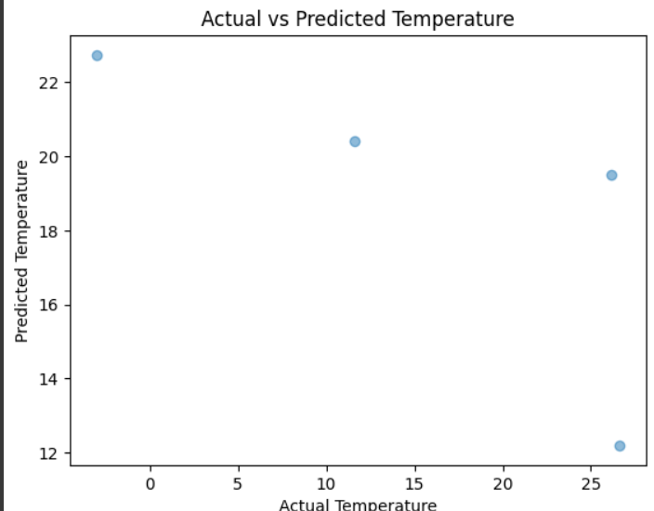
Analysis Result:

Slide 12
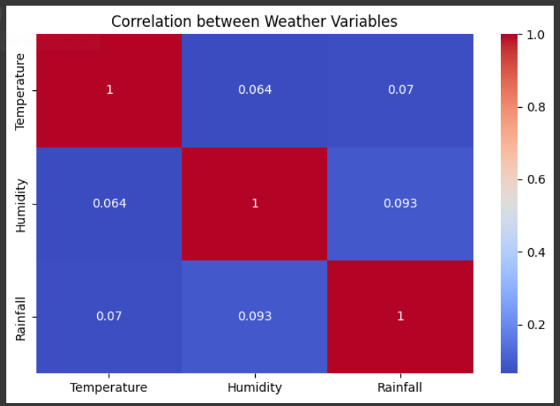

Slide 13
Thank You !

